Slide 1
NP-Complete

Slide 2
NP-complete! What’s next?
Lots of practical applications generate problems that are NP-complete
We can’t afford to give up
Three workarounds
For small inputs, write an exponential algorithm
Isolate important special cases that are solvable in polynomial time
Find near optimal solutions in poly time, if you can guarantee the bound of near optimality, it’s an Approximation Algorithm

Slide 3
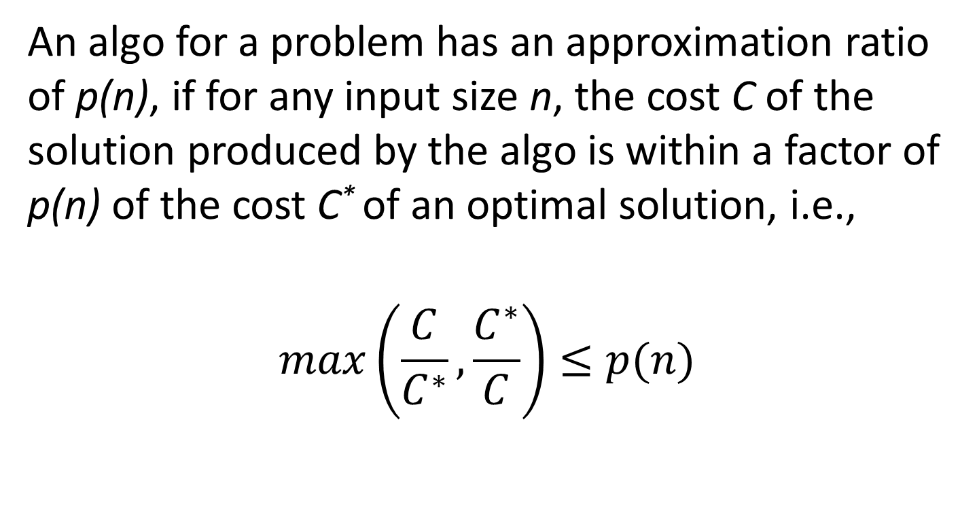
Approximation Ratio
An algo for a problem has an approximation ratio of p(n), if for any input size n, the cost C of the solution produced by the algo is within a factor of p(n) of the cost C* of an optimal solution, i.e.,
$$\max\left(\frac{C}{C^{∗}}, \frac{C^{∗}}{C}\right)≤p(n)$$
Minimization
problems
Maximization
problems

Slide 4
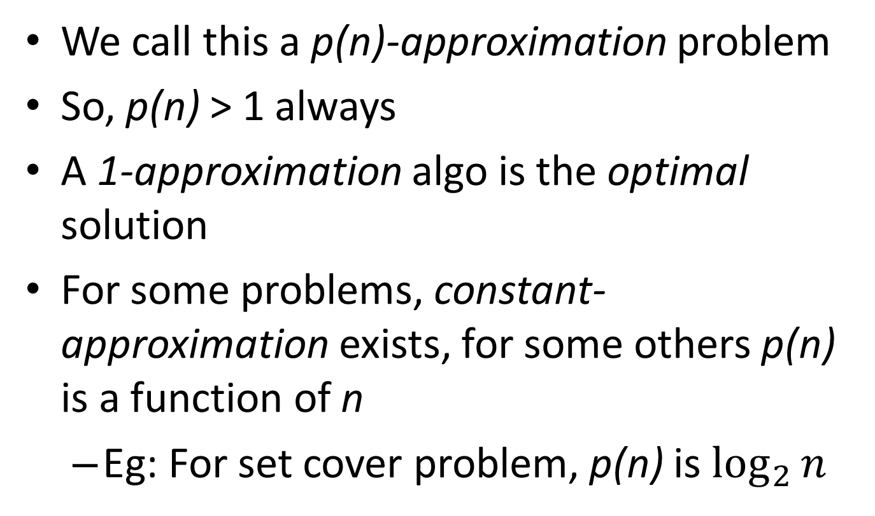
Contd.
We call this a p(n)-approximation problem
So, p(n) > 1 always
A 1-approximation algo is the optimal solution
For some problems, constant-approximation exists, for some others p(n) is a function of n
Eg: For set cover problem, p(n) is $\log_{2}{n}$

Slide 5
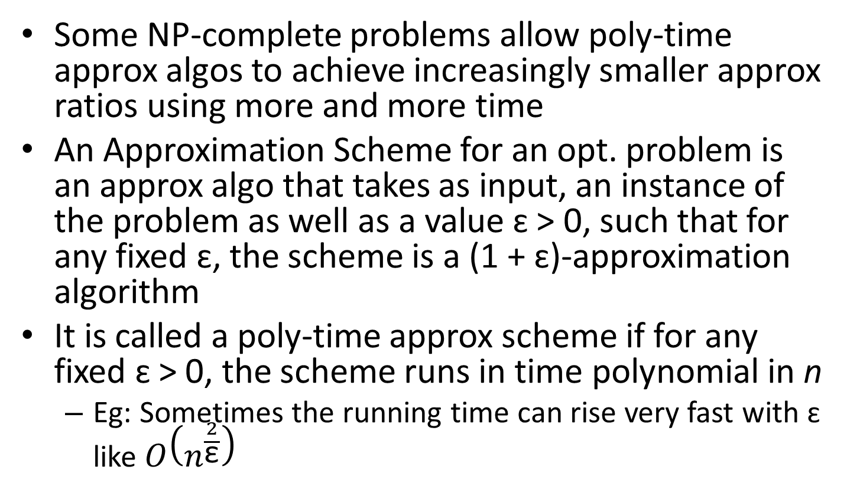
Approximation Algorithms
Some NP-complete problems allow poly-time approx algos to achieve increasingly smaller approx ratios using more and more time
An Approximation Scheme for an opt. problem is an approx algo that takes as input, an instance of the problem as well as a value ɛ > 0, such that for any fixed ɛ, the scheme is a (1 + ɛ)-approximation algorithm
It is called a poly-time approx scheme if for any fixed ɛ > 0, the scheme runs in time polynomial in n
Eg: Sometimes the running time can rise very fast with ɛ like $O\left(n^{\frac{2}{\text{ε}}}\right)$

Slide 6
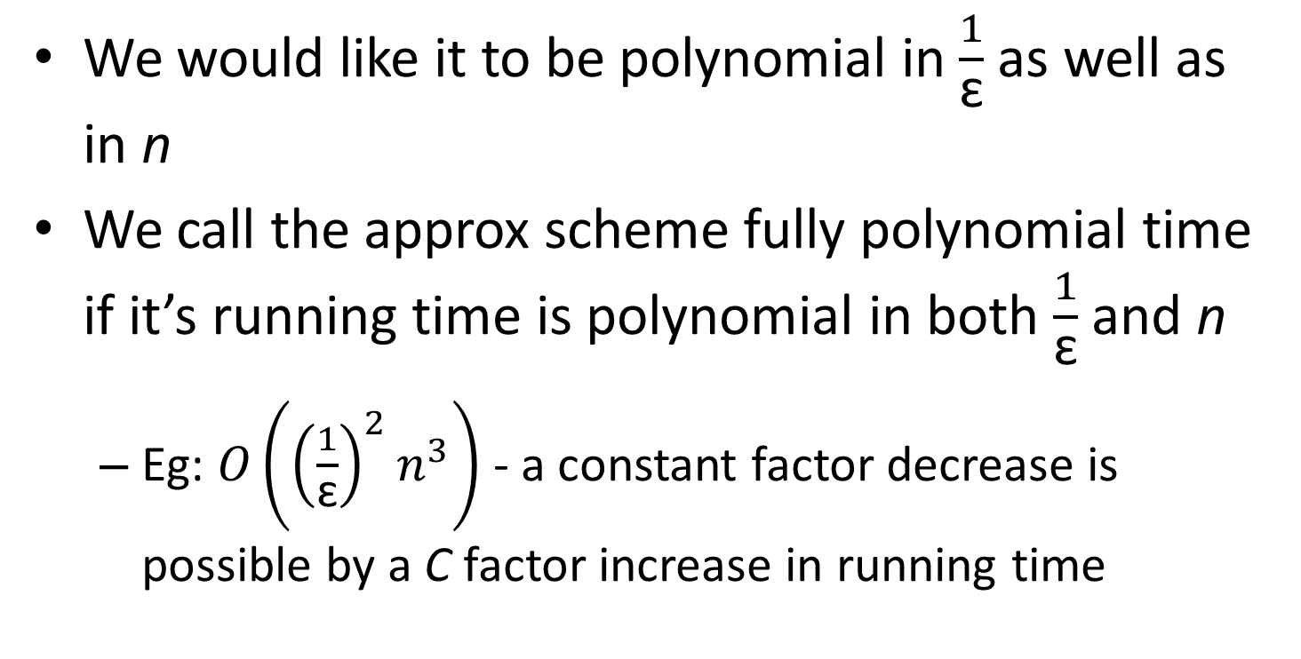
Contd.
We would like it to be polynomial in $\frac{1}{\text{ɛ}}$ as well as in n
We call the approx scheme fully polynomial time if it’s running time is polynomial in both $\frac{1}{\text{ɛ}}$ and n
Eg: $O\left({\left(\frac{1}{\text{ɛ}}\right)}^{2}n^{3}\right)$ - a constant factor decrease is possible by a C factor increase in running time

Slide 7
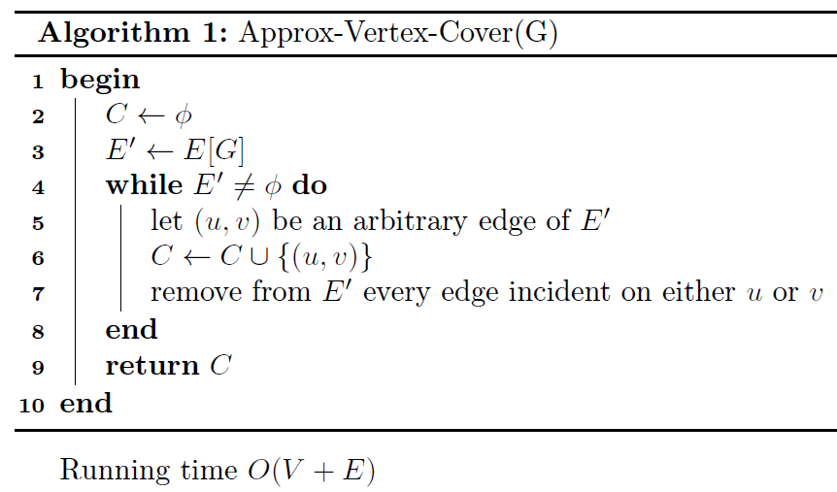

Slide 8
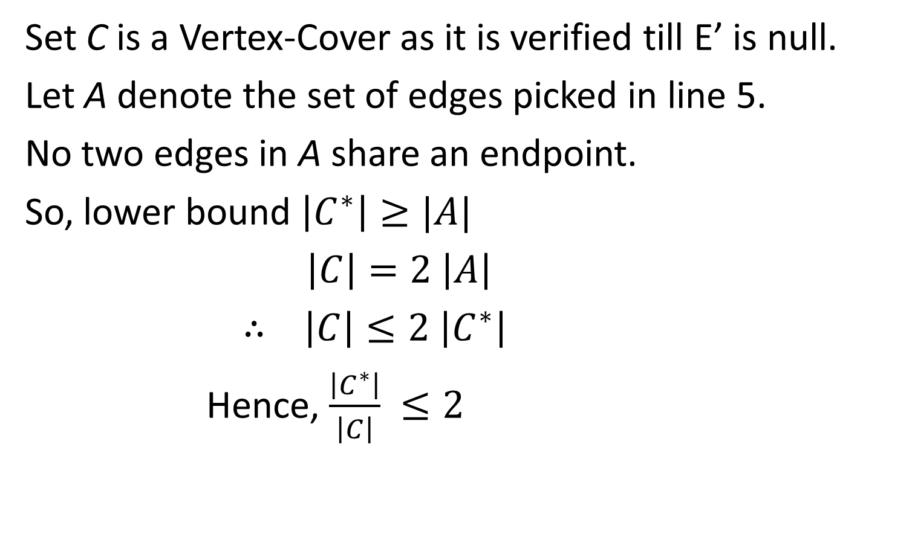
Theorem: The algo is 2-approximation algo
Set C is a Vertex-Cover as it is verified till E’ is null.
Let A denote the set of edges picked in line 5.
No two edges in A share an endpoint.
So, lower bound $\left|C^{∗}\right|≥|A|$
$\left|C\right|=2 \left|A\right|$
$∴ \left|C\right|≤2 \left|C^{∗}\right|$
Hence, $\frac{\left|C^{∗}\right|}{\left|C\right|} ≤2$

Slide 9
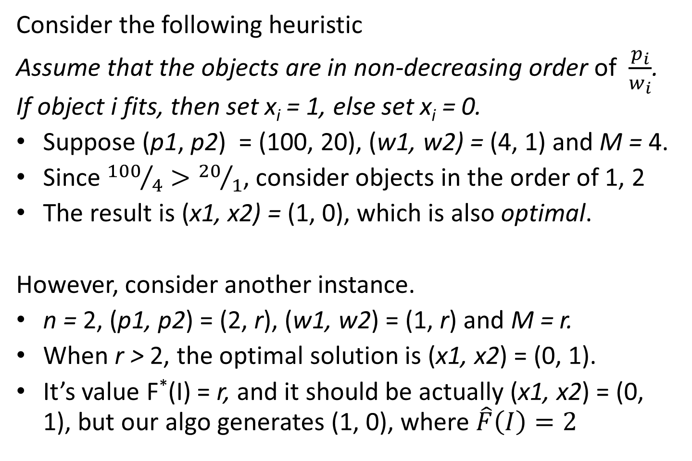
Approximation Algorithm for 0/1 Knapsack Problem
Consider the following heuristic
Assume that the objects are in non-decreasing order of $\frac{p_{i}}{w_{i}}$. If object i fits, then set x_{i} = 1, else set x_{i} = 0.
Suppose (p1, p2) = (100, 20), (w1, w2) = (4, 1) and M = 4.
Since ${100}/4>{20}/1$, consider objects in the order of 1, 2
The result is (x1, x2) = (1, 0), which is also optimal.
However, consider another instance.
n = 2, (p1, p2) = (2, r), (w1, w2) = (1, r) and M = r.
When r > 2, the optimal solution is (x1, x2) = (0, 1).
It’s value F*(I) = r, and it should be actually (x1, x2) = (0, 1), but our algo generates (1, 0), where $\hat{F}\left(I\right)=2$

Slide 10
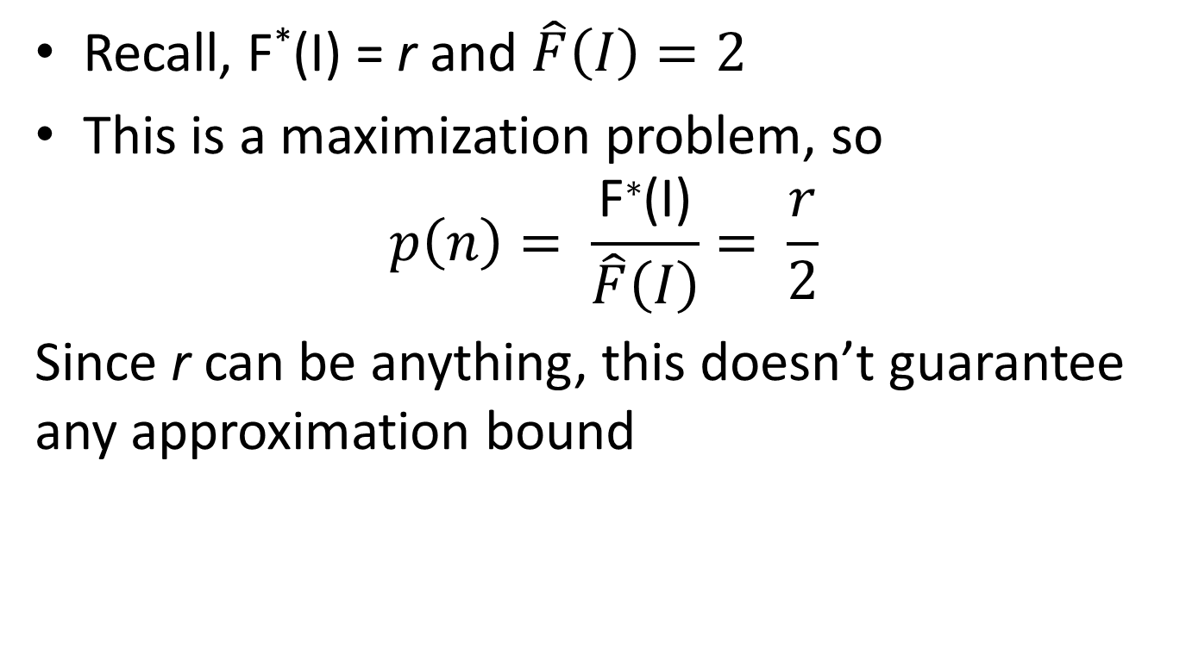
Contd.
Recall, F*(I) = r and $\hat{F}\left(I\right)=2$
This is a maximization problem, so
$$p\left(n\right)= \frac{\text{F}\text{∗}\text{(}\text{I}\text{)}}{\hat{F}\left(I\right)}= \frac{r}{2}$$
Since r can be anything, this doesn’t guarantee any approximation bound

Slide 11
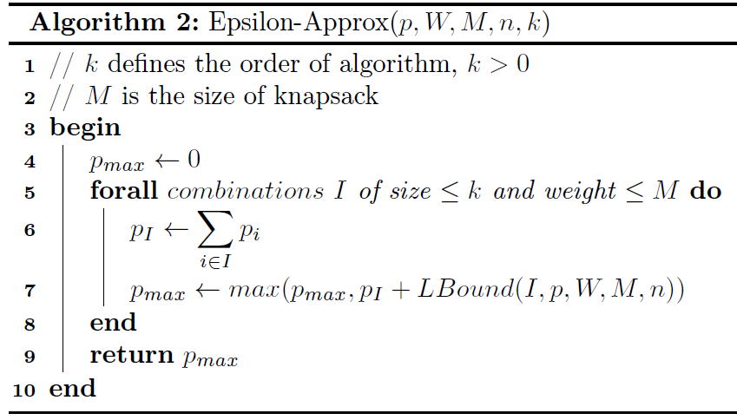
Approx Scheme for 0/1 Knapsack

Slide 12
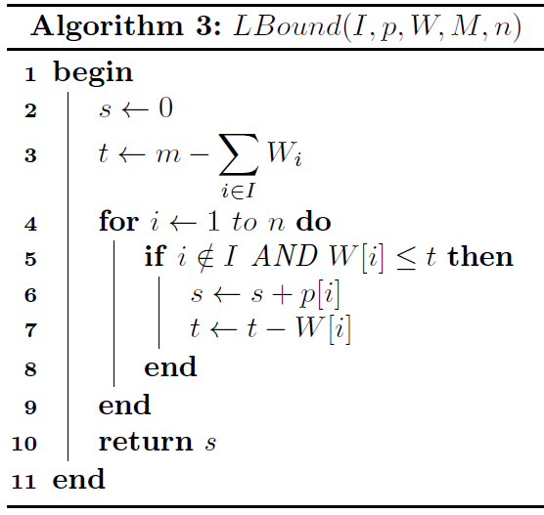

Slide 13
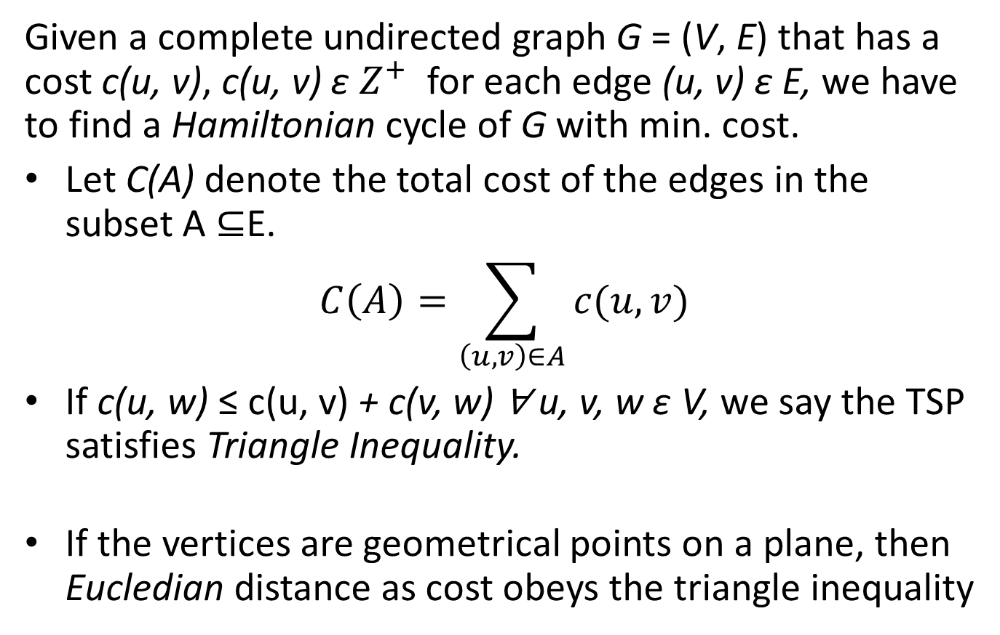
Traveling Salesman Problem
Given a complete undirected graph G = (V, E) that has a cost c(u, v), c(u, v) ɛ $Z^{+}$ for each edge (u, v) ɛ E, we have to find a Hamiltonian cycle of G with min. cost.
Let C(A) denote the total cost of the edges in the subset A ⊆E.
$$C\left(A\right)=\sum_{\left(u,v\right)∈A}{c(u,v)}$$
If c(u, w) ≤ c(u, v) + c(v, w) ∀ u, v, w ɛ V, we say the TSP satisfies Triangle Inequality.
If the vertices are geometrical points on a plane, then Eucledian distance as cost obeys the triangle inequality

Slide 14
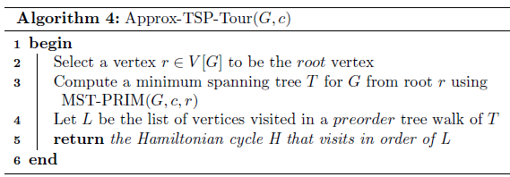
Approx Algo for TSP
The general TSP doesn’t have a constant approx algo
But the TSP with triangle inequality has a 2-approx algo

